Slide 1


3D House
Alisa Ermel

Slide 2


Press the sun to change Day to Night and back!

Slide 3
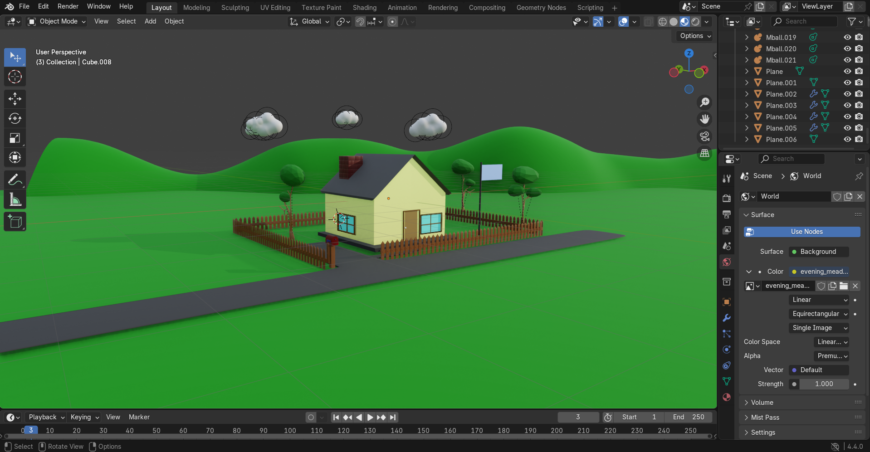

3D House: Blender
HDRs: https://polyhaven.com/hdris

Slide 4
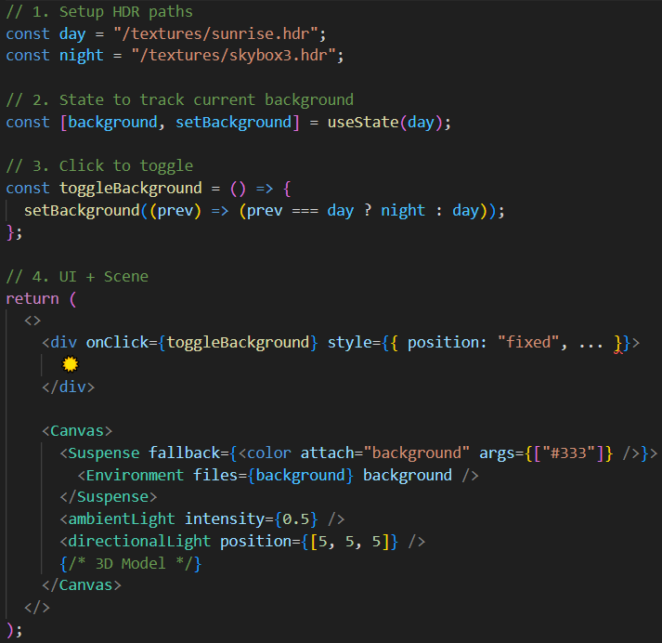
Dynamic Lighting Environment Switching
I use a dynamic HDR environment toggle in a Three.js scene with React. Users can switch between day and night lighting using a clickable UI. This is managed with useState and @react-three/drei’s <Environment>.
Key Points:
🌄 HDR textures provide realistic lighting and reflections
🔄 useState controls day/night mod
🖱 UI button triggers toggle
🧠 <Environment> handles lighting updates
⚡️ <Suspense> prevents loading glitches

Slide 5

Thank you!

